Slide 1
A MILLION STORIES MEMBERS – OMKAR WATVISAVE (2017172) SAURABH KUMAR (2017232) SPARSH AHUJA (2017258)
COURSE - DATABASE MANAGEMENT SYSTEMS (CS201)
INSTRUCTOR – DR. PRITEE KHANNA
INDIAN INSTITUTE OF INFORMATION
TECHNOLOGY, DESIGN AND MANUFACTURING, JABALPUR

Slide 2
ACKNOWLEDGEMENT
We would like to express our special thanks of gratitude to our professor Dr. Pritee Khanna for introducing this course to us and for encouraging us to work on this project and improve our knowledge of the same.
We also thank our seniors for helping us throughout the lab sessions.

Slide 3
OVERVIEW
‘A MILLION STORIES’ is a social platform developed for users to share their experiences and memorable events with their admirers through short stories. People will admire others without even knowing their face but by reading their posts and developing a more genuine kind of relation between the users. In today’s world of unreal online social connections this platform will serve the right purpose of bringing the world closer.

Slide 4
TABLE OF CONTENTS
INTRODUCTION
LITERATURE REVIEW
THEORETICAL FUNDAMENTALS
METHODOLOGY
IMPLEMENTATION
RESULTS

Slide 5
INTRODUCTION
A Million Stories' is a place full of motivation and true inspirational stories.
Here you're given a platform to come out and contribute to the world of true proses, a treasure from your own daily life..!
The only task that awaits your post sign up time is to express from your heartiest to your most depressed states .
Let few more souls connect with these , with their stories , with their projection of the day.

Slide 6
THEORETICAL FUNDAMENTALS
The fundamentals of DBMS – Creation of a Database, Using SQL Queries,
Working out php scripted files to process frontend and backend simultaneously.
Collaborating using Google Drive local server on desktop through wamp.

Slide 7
METHODOLOGY
First, a Relational schema was prepared to assemble all important Entities of the DB together in a normalised manner.
Use of WAMP to create the major database on MySQL server on a machine controlled by the DBA.
Insertion of tables in the database.
Creation of the operational Front-end and Back-end using HTML-CSS and PHP respectively.
Last step was to link all the pages and scripts to get a complete working protocol.

Slide 8
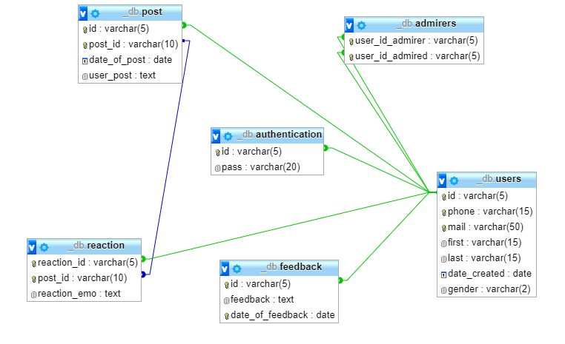
IMPLEMENTATION (Relational Model)

Slide 9

RESULTS
Fully functional website home-page :-
May direct the user to the About page,
The login page and Sign-up page.

Slide 10
REFERENCES
https://www.w3schools.com
GOOGLE

